Slide 1
A CHAPTER-WISE UNDERSTANDING SYSTEM FOR TEXT-TO-SPEECH IN CHINESE NOVELS
Zhiling Zhang
2021.11

Slide 2
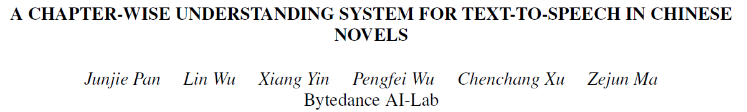
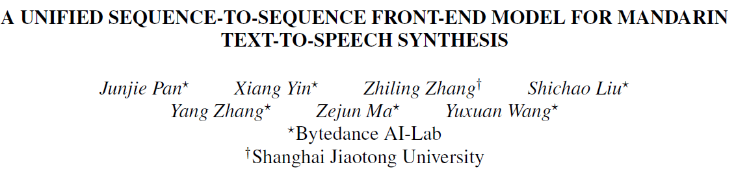
ICASSP 2021
ICASSP 2020
Notes:
This is an ICASSP 2021 paper from Bytedance AI-Lab. I choose this paper because I also contributed much to this project during my internship at that group in 2019.
Unfortunately, my name is not on it because this paper was written long after I’ve left there. But I have got the verbal acknowledgement of my contribution from the first author.
And there is another ICASSP 2020 paper with my name when I’m still there. So after all, I would still proudly introduce this project as one of its main contributors.

Slide 3
Outline
Introduction
Methods and Results
Discussion

Slide 4

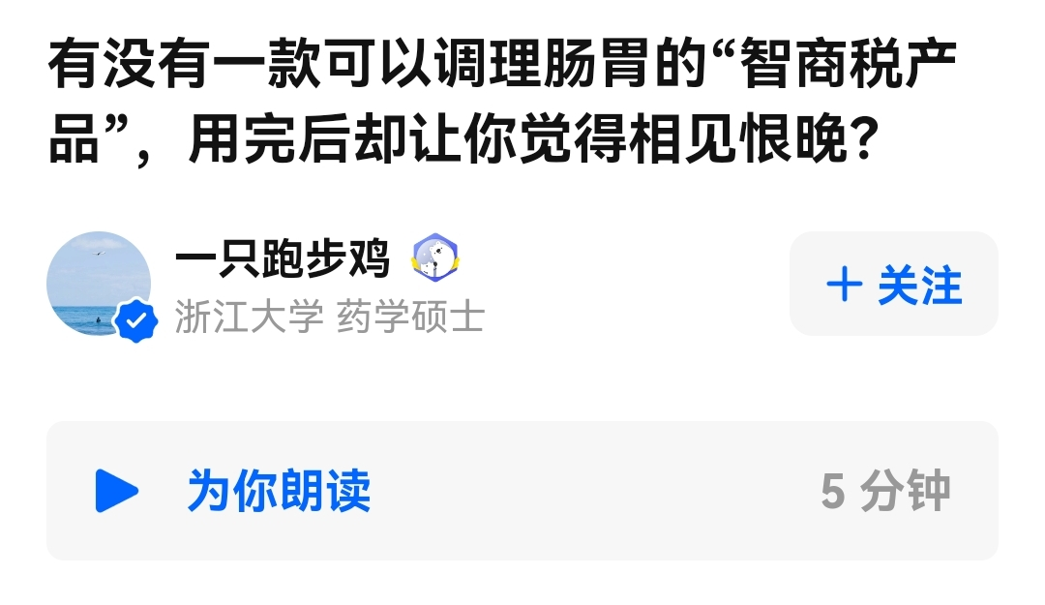
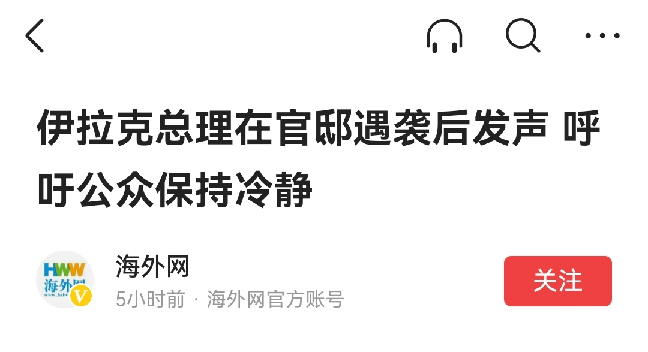
Typical Text-To-Speech (TTS)
Requirement: Clear and Natural
Scenario: News Reading, Maps, calling systems (e.g. hospital), …
However, some apps like audiobooks have even higher requirements
今日头条
知乎
Notes:
This paper is about TTS for novels, they are different from typical TTS, so let’s have an impression on typical TTS first.
They are all extracted from famous APPs, do you know where do they come from? Xxx
The requirement of typical TTS systems are clear and natural, so that we can easily absorb information from them.
知乎’s TTS is clear enough, but very unnatural.
Such systems have already been used in news reading, maps and simple calling systems. And I think news reading has a much higher requirement on naturalness，so I think 知乎’s TTS is hardly usable.
Today’s SOTA TTS is already close to human in naturalness, and I guess many of you have already been used to this.
So one day I give Zelin a human recording from 喜马拉雅, he asks me if it is TTS.
However, xxx

Slide 5
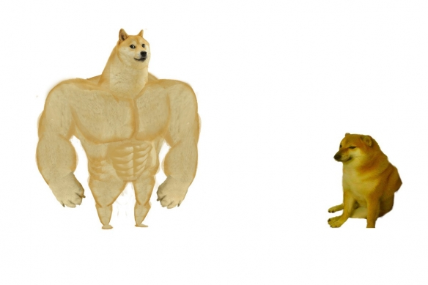
Expressive Audiobooks
Example: 《三体》有声剧 from 喜马拉雅 (Professional human team)
Narrator-Speaker style
Multi-Speaker
Emotions
Subtle tones
Sound Effects
Levels
S-level: professional production team (All of above)
A-level: amateur production team (Several of above)
B-level: individual producers (None or a few of above)
“C-level”: traditional TTS-system
professional team
TTS
Notes:
That is expressiveness. I will play a very good human recording and let’s see how expressive can human do. (play)
Compared to the previous TTS system. Which aspects do you think it is better?
In this paper, the authors defined levels of expressive audiobooks. S-level are produced by xxx, which can have all of the above strengths. And they are followed by A-level and B-level audiobooks.
So compared to them, even the most natural traditional TTS system may only fall into C-level

Slide 6
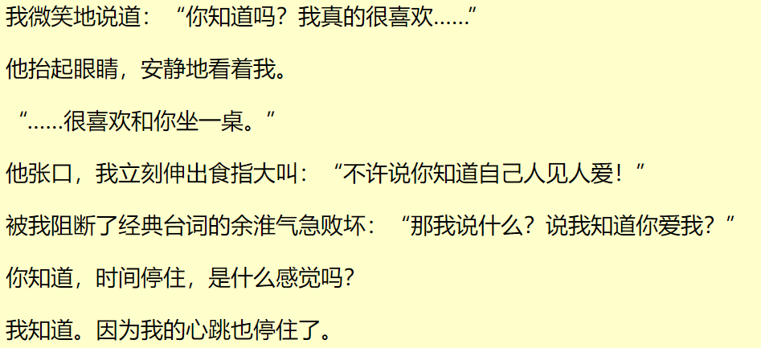
Non-Expressive TTS
“C-level”: Typical TTS with unstructured raw text
Lack of expressiveness, boring to users
Notes:
Let’s have a taste on typical TTS for novels
This part is supposed to have strong emotion right? But the TTS is very plain.
It lacks xx
So how can we improve our TTS system, so that it step up the ladders and achieve B-level performance?

Slide 7
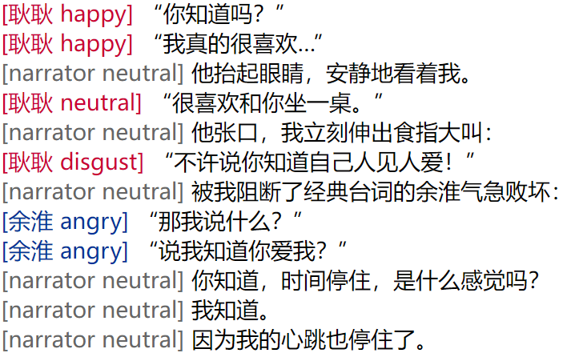
NLU for Expressive TTS
Expressive TTS with structured script
Speaker & Emotion annotation with NLU system
Notes:
The answer is NLU.
We can use NLU to extract the key attributes we have discovered from the S-level audiobooks like speakers and emotions, and incorporate them into the TTS system.
The NLU result is presented as an annotated script. let’s listen to an example of it.
Although the result is not prefect, we can at least feel that the specific expression of emotions and speakers

Slide 8
Chapter-wise NLU for Expressive TTS
Consistent speaker for the same person within the chapter
Person Name Recognition (PerNER)
Speaker Identification (SID)
Coreference Resolution (CoRef)
Reasonable emotion evolvement along the chapter
Contextualized Emotion Classification
Adjusted
Novel Task
Reformulation
Reformulation
Notes:
Note that we need a chapter-wise NLU system here, because we need xxx and xxx
This new setting, or the larger granularity of chapter brought many new challenges.
Therefore, we have some novel tasks here, and also many reformulations on classical NLP tasks, including xxx
I will explain them in details later.

Slide 9
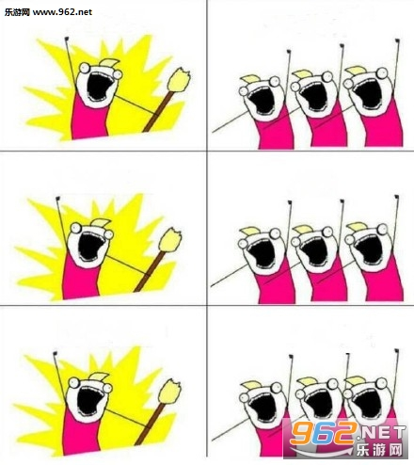
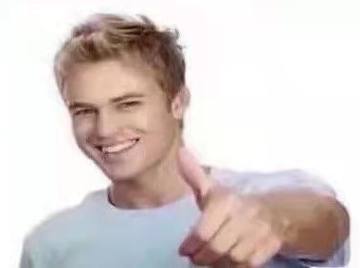
Special consideration for application-oriented research
Competition/Publication-oriented research
Application-oriented research
Complex decision, may need trade-offs
I'm the
SOTA!
I proposed a
Novel (complex) method!
Accept my paper!
Simple,
Efficient,
Effective!
max Profit = a*Performance – b*cost
s.t. Latency < x
Complexity < y
(tolerable for user)
(programmer can finish in time)
Notes:
Before discussing the details of the paper. I’d like to first introduce some special characteristics of this paper, as an application-oriented research.
In publication-oriented research, our goal is like this.
In short, we focus on performance, and some people may design very complex methods, so that the reviewers will think they are strong and novel.
In contrast, in application-oriented research, our goal may look like this.
It can be a really complex decision, so you will see later that we often trade some performance for efficiency. And the implementation should better be simple, so the programmer don’t need 996 for this.
After all, in application, we want simple, efficient and effective!

Slide 10
Outline
Introduction
Methods and Results
Discussion
Notes:
Now let’s go to the methods

Slide 11
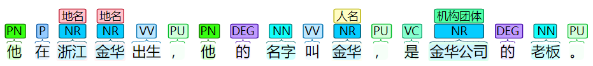
Person Name Recognition (PerNER)
Typical NER
Mainly People, Location and Organization entities
Person Name Recognition (PerNER)
More about person entities, including names, titles(头衔) and pronouns(代词)
No other entity types like locations and organizations
他在浙江金华出生，他的名字叫金华，是金华公司的老板。
Notes:
The first task is Person Name Recognition. It is similar to typical NER, but with slight modifications on the goal.
While in PerNER, we don’t need to recognize location and organizations, but we need to find more about people, including titles and pronouns usually not covered in NER.

Slide 12
Sequence Tagging for PerNER
Person Name Recognition (PerNER)
All kinds of person entities, including names, titles and pronouns(代词)
Sequence Tagging (BMEIO)
B-Begin, M-middle, E-end, I-individual, O-out
Quiz: Spot the person mentions and label the sentence
他在浙江金华出生，他的名字叫金华，是金华公司的总经理。
I O O O O O O O O I O O O O B E O O O O O O O B M E O
宁成海上门，居然不是为了老爸，而是陈潇，看样子还是有求于他。
B M E O O O O O O O O O B E O O O B E O O O O O O O O O I O
Notes:
As is used for typical NER, we can deal with PerNER with sequence tagging. Here we use the BMEIO scheme, so the tagging sequence for the previous example will look like this.
You don’t need to tell me the whole tag sequence, just tell me what are the mentions, and how to label the names

Slide 13
PerNER augmentation
Chinese family name replacement
网球运动员李娜 → 网球运动员谢娜
Title replacement
江主席致辞 → 江学长致辞
Whole name replacement
我老公是王一博 → 我老公是郭德纲
Conventional augmentation for other parts
当你说今天的烦恼 → 当你说今天的忧愁
PerNER
Specific
Dictionary-based
Easy to implement
Simple and Effective
“Lack of Novelty” from research’s perspective
Notes:
The authors designed many augmentation strategies for this task, like xxx
We can see the first 3 is specific to PerNER
And all of them can be implemented with dictionaries, so they are quite simple.
So you can see, such tricks are common in industrial projects, they are simple and effective, but may be considered xxx

Slide 14
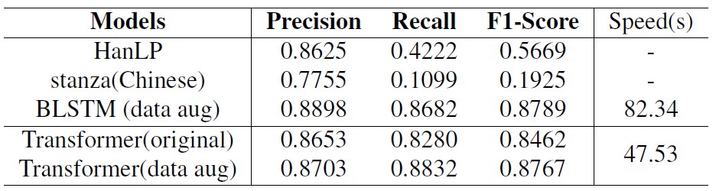
PerNER Experiments
Classical NER pretrained-model
HanLP: one of the most popular Chinese NLP toolkit
Stanza: Stanford NLP
PerNER model: BLSTM/Transformer + CRF
Inference
Notes:
Now let’s see their performance.
They use popular models for classical NER as baselines, so the comparison is not totally fair. But you can see the effect of the reformulation in the new task. And the proposed model are BLSTM/Transformer + CRF.
Domain gap and formulation gap (they don’t include pronouns)
For practical concerns, given similar F1, we will prefer the most efficient one

Slide 15
Speaker Identification (SID)
Identify the speaker of a quote from texts
Match quote with a person mention (PerNER) who speaks it
Notes:
OK, let’s move to another task, SID.
The goal is to
I will show an example

Slide 16
SID: Formulation
Multi-class classification
Input: a quote and its context
Label set: character list
Number of class not fixed for different chapters/novels!
Pairwise-matching
Input: features from each quote-person pair
Target: if the quote is spoken by the person
Binary classification, won’t vary across chapters
Notes:
Since it is a new task for novel understanding, how can we formulate it?
A model trained on a chapter will be useless for another chapter
So we come up with another formulation

Slide 17
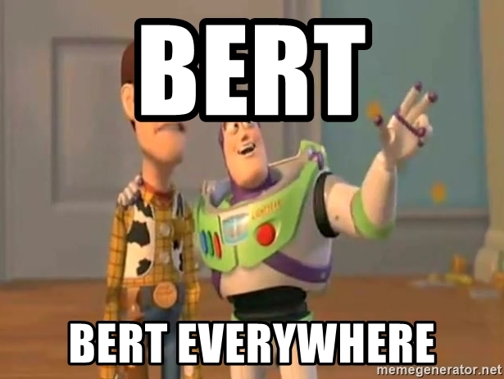
SID: Modeling choices
BERT-based model
Encode the center quote and its context as embedding
Take the embedding of the person mention as the character embedding
Feature engineering + traditional ML models
Manually define features for each pair
E.g. person-quote distance, if a sentence contains dialog words like “说”
Which one will win?
Feature engineering!
Notes:
Given the pairwise-matching formulation, how can we solve it?
Here I give 2 possible approaches.
The first is to use BERT, since we are now using BERT everywhere, right?
We can xxx
Another is to use feature engineering and feed the features into a traditional ML model.
We can manually xxx
You can guess which one is better.
I will reveal the answer first, that is feature engineering

Slide 18
SID: Features
Discussion: Which features will you design for SID?
Notes:
We designed many features for this task. Most of them are trivial so I think it would be boring to introduce them one by one.
So I want you to discuss first. Which features will you design for SID?
You can refer to the example and try to tell me some.

Slide 19
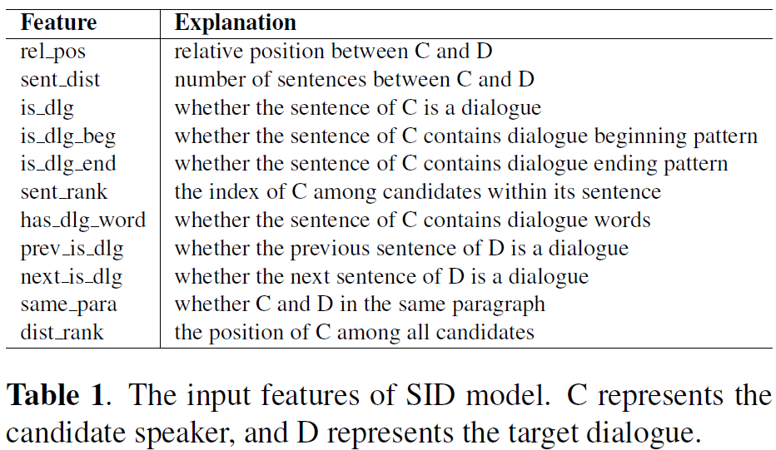
SID: Features
Notes:
OK, these are the features that I proposed. They are mainly structural clues like distance and position, and some semantic features like if a sentence contains dialogue words like “说”. They are simple so I will just go on.

Slide 20
SID Results
Features + GBDT-based model (lightGBM/xgboost)
Accuracy
Feature engineering 87.03% V.S. BERT+feature 76.40%
Reasons for BERT’s failure
BERT focus more on semantic information
However, this task requires more structural clues rather than semantics
Features directly capture this, also simple and efficient

Slide 21
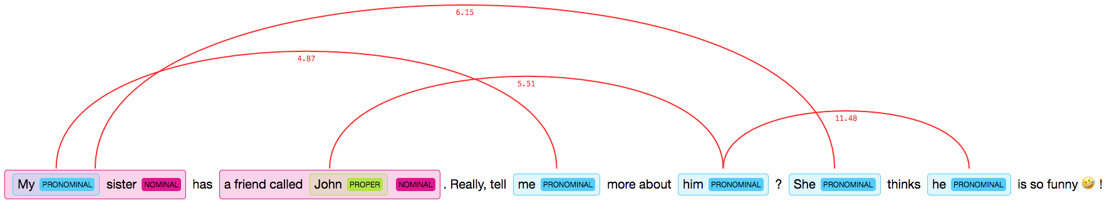
Coreference Resolution (traditional)
Winograd Schema Challenge (WSC)
The trophy doesn’t fit in the brown suitcase because it is too big.
What is too big? A. The trophy B. The suitcase
Binary choice, candidates in one sentence
OntoNotes 5.0 / CoNLL 2012
Pairwise-span matching, within several sentences
Notes:
The next task is coreference resolution.
The formulation here is also different from traditional settings. So let’s see how we conduct traditional coreference resolution.
The first setting is xxx

Slide 22
Chapter-wise PerNER Coref
Candidates: Person names only, no other entities
Primary name (Standard name across chapter/book)
Name starting with Chinese family names
Or the most frequent K mentions in a chapter/book
Candidate name (temporary mention of a character)
Other names except primary names
New formulation: Match each candidate to a primary name
Candidate | 杰伦 | “行走的CD” | 王思聪的爹 | 他
Primary | 周杰伦 | 林俊杰 | 王健林 | XXX
Notes:
How we formulate our coreference resolution here?
First, the candidates comes from PerNER, so it deals with Person name only, and don’t care about other entities
Next, when reading a novel, we usually refer to a character with a standard name, but the character can actually be called in many ways like 他 or 老板.
Therefore, we distinguish primary names and candidate names. Primary names are xxx
Finally, we formulate the problem as matching each candidate to a primary name.
This table shows an example, and we can see there are many ways to refer to a person. And some references like 他 can only be decided with context.
To extract primary names and candidate names from text, we use these rules xxx

Slide 23
Quiz: Coref
“罗辑的破壁人就是他自己，他需要自己找出他对主的威胁所在。”秦始皇说。 ……
“所有的面壁者中，罗辑是不是最大的威胁？”有人小心翼翼地问。 “这我们也不知道，只有一点是清楚的，”秦始皇仰望着在蓝黑间变幻的天幕说，“在四个面壁者中。只有他，直接与主对决。”
1. Primary names?
2. Find their primary names
罗辑、秦始皇、（主）
Candidate | 罗辑的破壁人 | 他自己 | 秦始皇 | 有人 | 四个面壁者
Primary | 罗辑 | 罗辑 | 秦始皇 | ？ | N/A
Notes:
There are also many tricky cases. For example, we can’t find a primary name for “有人”, but he does spoke something. We have some special treatment for them, but they are trivial annotation details, so I will skip them.

Slide 24
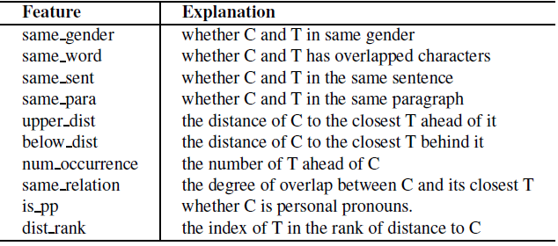
Coref: methods
杰伦
Assign each candidate to the most possible primary name
Assign primary name to itself or another primary name
In case 2 primary names actually refer to the same person
Matching (Binary classification) with features
周杰伦
周董
Notes:
Now let’s discuss the method to solve the problem.
It uses two-stage matching
Again it uses pairwise features for matching, they are intuitive, so I will skip them.

Slide 25
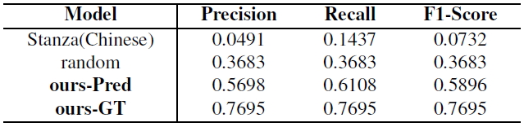
Coref Experiments
CoRef Results
Ours-Pred: Input names from PerNER predictions
Ours-GT: Input names from human labels
Failure of Stanza
Following traditional NER, thus low recall on PerNER
Using traditional Coref, hard to handle long distance

Slide 26
Speaker Determination Pipeline
Person name recognition (PerNER)
Speaker Identification (SID)
Coreference Resolution
Candidate | 我(1,1) | 他(2,1) | …
Primary | 耿耿 | 余淮 | …

Slide 27
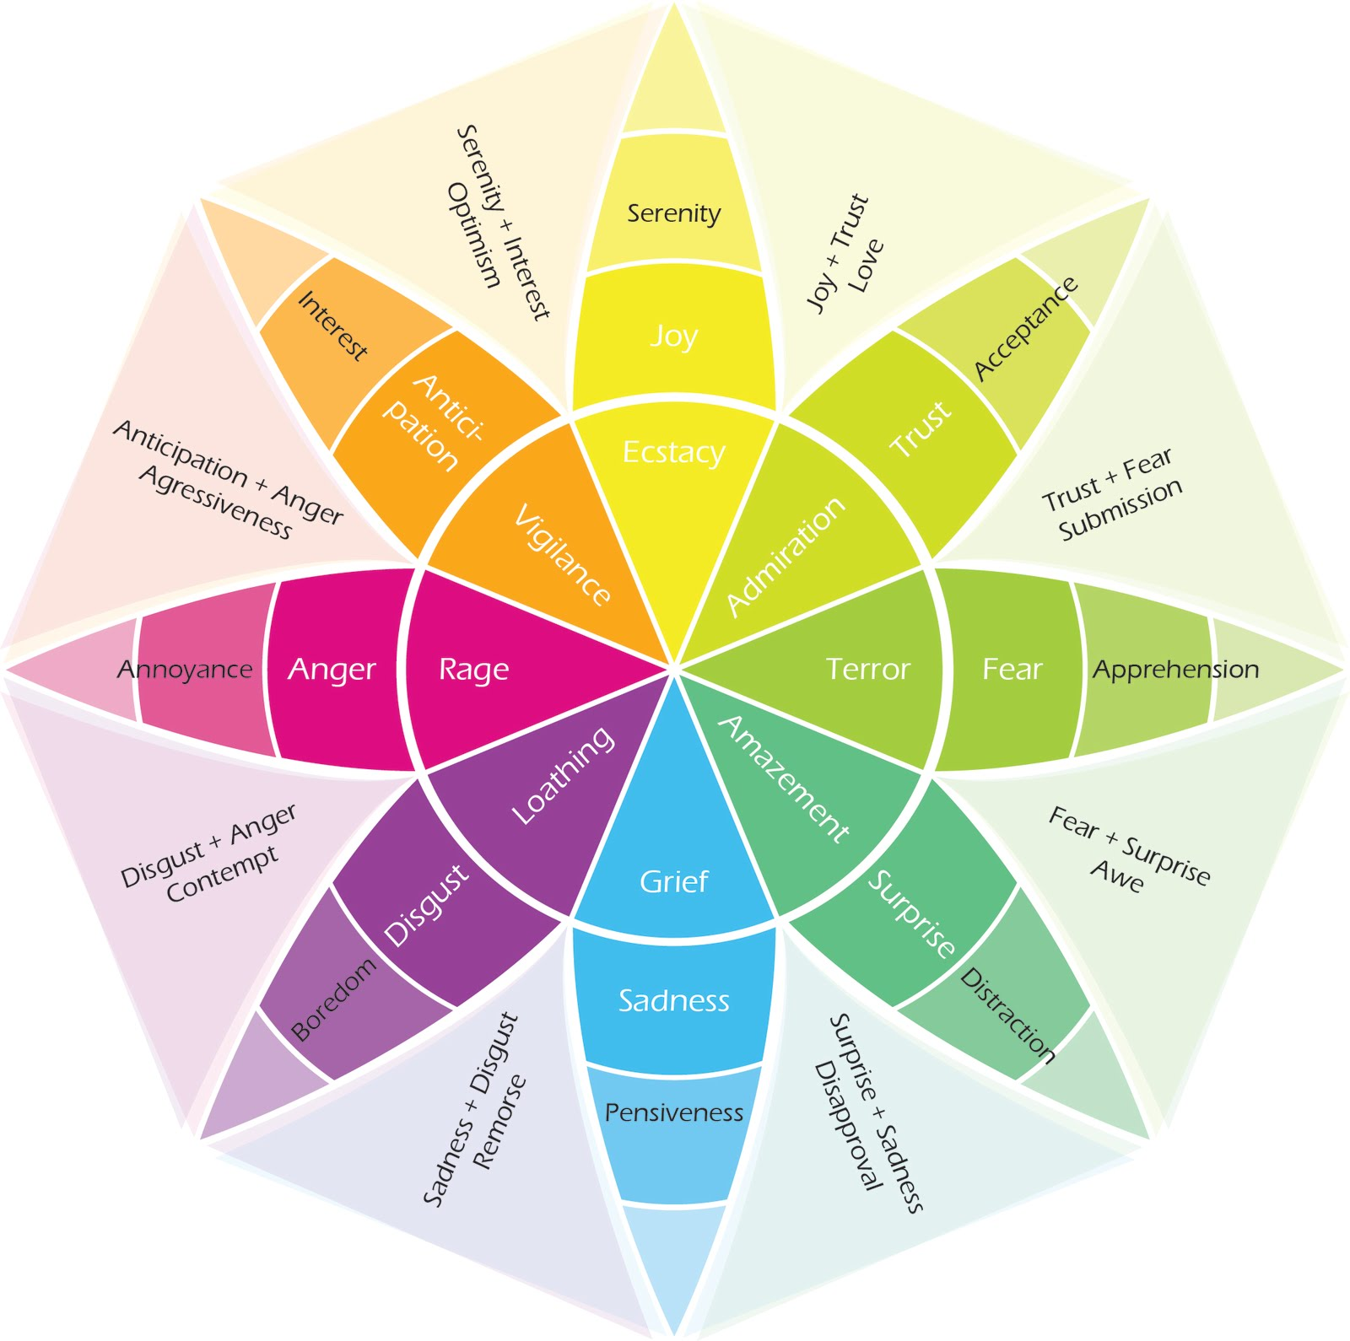
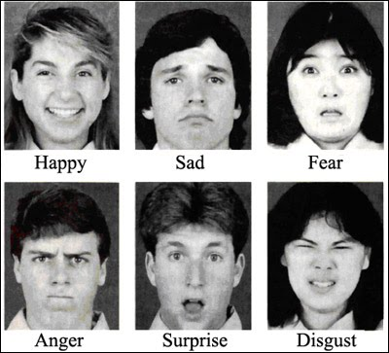
Emotion Classification
Sentiment analysis
Positive, Negative, (Neutral)
Emotion detection from classical psychological theories
Left: Ekman’s 6 universal emotions
Right: Plutchik’s wheel of emotions
8 dimensions
× 3 levels
+ mixture of dimensions
Annoyance < Anger < Rage
😠 😤 😡
Notes:
Now we move to our second focus, emotion classification.
Also let’s review the typical emotion classification settings first.
We usually use the term sentiment analysis to refer to the binary classification of positive and negative emotions
And we use emotion detection/classification for more specific emotions.
We have 2 classical theories for this

Slide 28
Emotion Classification for TTS
Special Characteristics
Only for spoken contents (quotes), as opposed to voiceovers (旁白)
Can be expressed through voice (so that audience can feel)
Can be identified from text (so works can annotate)
Problems of classical definitions
Binary sentiment analysis: not diverse and expressive enough
Ekman’s 6: Identified mainly from facial expressions
Plutchik’s 8: Derived from psychoevolutionary theory (进化心理学)
Notes:
The emotion classification for TTS has some special characteristics
Therefore, we may not simply adopt the classical definitions here.
Ekman’s 6 and Plutichik’s 8 are from other domains and may not perfectly fit the need of TTS.

Slide 29
Defining the Emotions (Refine process)
Starting from Plutchik’s 8x3 emotions
Remove words of different levels on the same dimension, not distinguishable
Add more voice-expressive “emotions” that can be easily identified
E.g. 害羞、着急、阴险 、疲惫
19 emotions decided at last for annotation
Eliminating low inter-rater agreement ones from 20+ proposals
Merged into 7 emotions in practice
Neutral, happy, anger, disgust, sadness, surprise, fear
Due to difficulty in the prediction of some scarce classes
Notes:
So how we define emotions for TTS here. We actually a refining process
这种选定情感的方式可能不是最优的，因为似乎语音中有12种比较能明显区分的情感 The primacy of categories in the recognition of 12 emotions in speech prosody across two cultures

Slide 30
Contextual Emotion Annotation
A whole chapter shown to annotators
Deciding emotions from sufficient context
Annotate emotions for all sentences (beyond quotes)
Other sentences also contain clues of emotions
我微笑/强颜欢笑着说：“我很开心。”
Allow multiple emotion annotations on the same sentence
Complex emotions of the same person, or multiple characters’ emotions
More than 2 annotators on the same chapter, and one checker
Compare the annotations, and make corrections if necessary
Ensure high agreement, but also preserve different reasonable opinions
Notes:
There are many special considerations in the annotation process
The annotation is actually very expensive, each annotator may need 20 minutes to an hour to finish a chapter
And to complete a book of about 120 chapters, it spent roughly 3 weeks for 4 annotators and me as the checker.

Slide 31
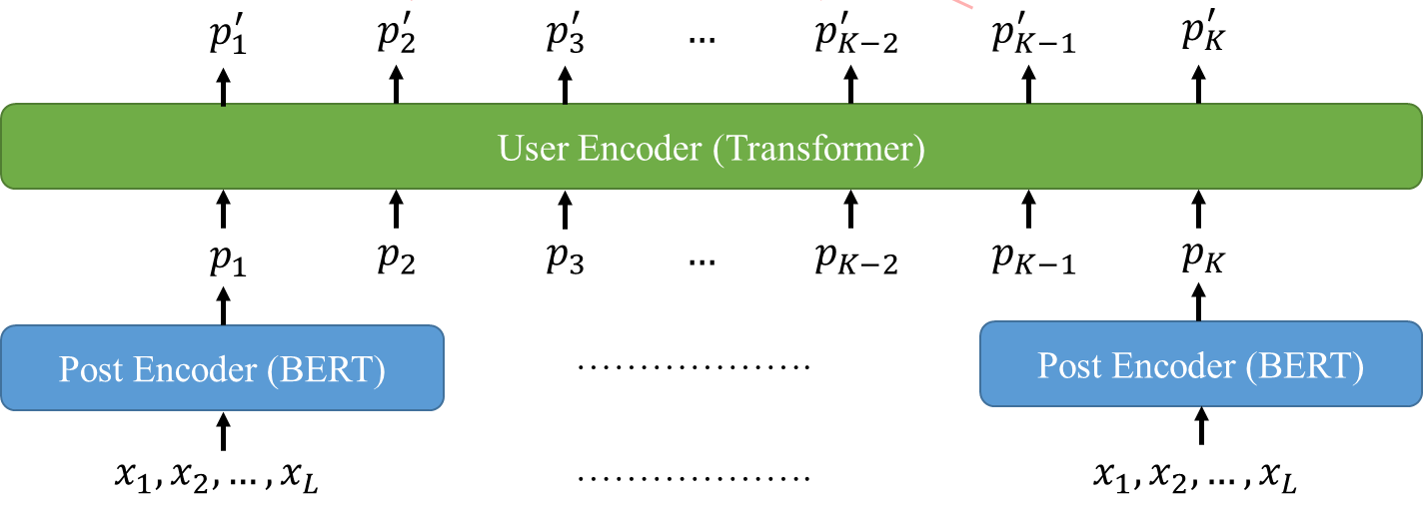
Emotion Classification (modeling choices)
Hierarchical Network
Input: one center sentence and 4 sentences before and after
BERT encoder for each sentence
CNN on top to model the interaction of sentences
Leverage context for better prediction on quotes
Context encoder (CNN)
Notes:
I also used a similar structure for my recent work of depression detection, so borrowed this image as an illustration

Slide 32
Emotion Classification (modeling choices)
Multi-label classification
Target: reasonable labels given by all annotators
Leverage the uncertainty in emotions and their relations
Only one highest-confidence emotion used for TTS
0
0
1
0
0
0
0
0
0
0
0
1
0
0
0
0
1
0
1
0
0
0
0
0.9
0
0.8
0
0
😞
Model
😞
😀
😤
Prediction
For TTS
Ann1
Ann2
Target
Probability
Notes:
xxx
This is the model I proposed initially

Slide 33
Emotion Classification (revised)
Efficiency! Efficiency! Efficiency!
Hundreds of hours of speech produced each day
BERT+CNN → 1-layer Bi-LSTM
Hierarchical Network → “Flat” Network
Input: one center sentence + 1 sentence before and after
Concatenate sentence index embedding with word embedding
Vocabulary: limited to an emotional word dictionary
Only put emotion words into the input sequence
Notes:
But to put into practice, we have a high requirement on efficiency, as they need to produce xxx
Therefore, in the final publication after one year they xxx

Slide 34
Quiz: Input of emotion classifier
“自从进入太空军后，你的情绪一直很低落。”
“你应该知道原因吧，你总是能轻易看到我的思想，有时候看得比我还透彻，经你提醒，我才知道自己真正想的是什么”
章北海转身直视着吴岳，
“对于投身于一场注定要失败的战争，你感到悲哀。”
“你很羨慕最后的那一代太空军，在年轻时就能战斗到最后，与舰队一起埋葬在太空。”
“但把一生的心血 耗尽在这样一个亳无希望的事业上，对你来说确实很难”
What is the input for the classification of the underlined sentence? (emotional words in bold)
Sequence: 直视 失败 悲哀 羡慕 年轻 战斗 埋葬
Sent Index: 0 1 1 2 2 2 2
Notes:
Now we need to predict the emotion of the underlined sentence. According to our rule,

Slide 35
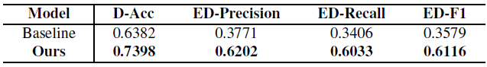
Emotion Classification Experiments
Metrics:
D-Acc: emotion accuracy in dialogues
ED-Precision/Recall/F1: P/R/F for non-neutral emotions in dialogues
Baseline: Naïve Bayes
Notes:
Now let’s see the experimental results

Slide 36
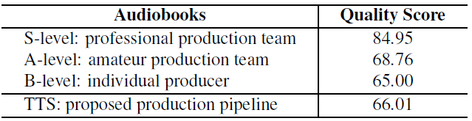
Overall Evaluation
Average quality score rated by human
Compare with human-made audiobooks
S-level: professional production team
A-level: amateur production team
B-level: individual producers
TTS comparable with individual producers (B-level)
Notes:
Now we put them altogether the evaluate the whole system.

Slide 37
Outline
Introduction
Methods and Results
Discussion

Slide 38
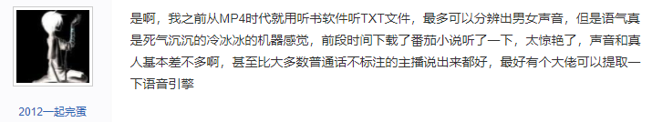
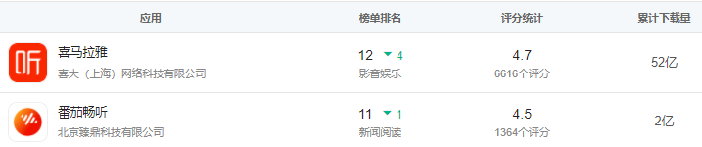
Broader Impact (Platform)
TTS of good quality, and Free! (due to low cost of AI)
Game-changer, Threatening the old players with human recordings
Starting Time:
2016-07
2016-07
2020-06
2016-07
Notes:
Since the TTS is of good quality and free, due to the low cost of AI. It has received good comments from the users.
Therefore, it has become a game-changer, threatening the old players who uses human recordings like 喜马拉雅 and 荔枝
We can see that 番茄畅听 is much younger than them, but the downloads are already high
So this technique has made much money for Bytedance

Slide 39
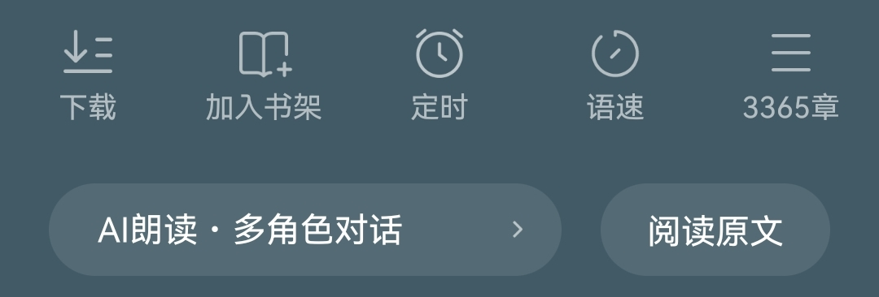
Broader Impact (User)
Review from a user
“这个人读的还可以，就是有点中气不足”
Unaware of the AI behind, passing the Turing Test
Can be used for bad applications, like telecommunication fraud
Clearly indicate its fakeness (recommended to put in law)
Notes:
For the impact on user, let’s see this review first.
We can infer that he is unaware of the AI behind. In other words, the TTS system can pass the Turing Test
Such human-like system can be used xxx
To avoid such bad influences, the APP must clearly indicate its fakeness, like I marked here Some experts have recommended to put this in law.

Slide 40

Broader Impact (Producer)
Threaten the jobs the low-level practitioners (like byworkers 副业人)
Create another kind of producer jobs?
Simply finetuning TTS results instead of recording ourselves
Correcting prediction errors, adding sound effects, etc.
Notes:
And for the producers of the audiobooks. Actually, this job has become a popular 副业
I can see advertisements like this everywhere.
But you have seen that TTS can already perform better than common people. So I don’t believe we can perform better than TTS with 3-day training.
Therefore, low-level practitioners like those from these classes can be easily replaced by AI.
But on another perspective, TTS can also xxx. It may create another kind of producer jobs, who simply finetune the TTS results to make it better.

Slide 41
Conclusions
Expressive audiobook calls for multi-speaker, emotional TTS
New Chapter-wise NLU pipeline for novels
Person Name Recognition (PerNER)
Speaker Identification (SID)
Coreference Resolution (CoRef)
Contextualized Emotion Classification
Performance-Efficiency-Complexity tradeoffs for application
Potential broader impact worth discussing
Adjusted
Novel Task
Reformulation
Reformulation

